Slide 1


Atomic Bikes Business Plan
Austin Adams – CEO
Ben Benyehuda – CMO
Arden Geffen – COO
Gus Lipkin – CIO
Richard Martin – CFO

Slide 2
Executive Summary/Agenda
Who is “Atomic Bikes?”
Three Stellar Products in Strategic Locations
Strong Marketing Approach
Operationally Efficient
Strong Finances + Our Request

Slide 3
Business Description
Arden Geffen – COO & VP of HR
This department oversees overseeing the compensation and satisfaction of all employees with the company, while monitoring industry trends for employee compensation, they also do the same for employee satisfaction as to ensure that productivity does not decrease during production.

Slide 4
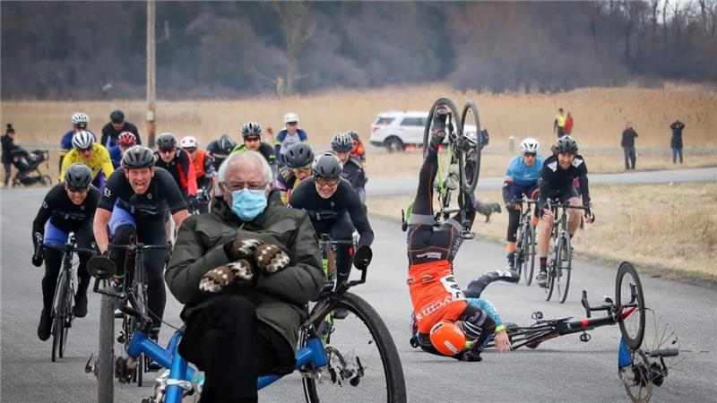
Mission Statement
To be a profitable high-quality bicycle company, deliver value to our customers, and attract, recruit, and retain smart and hard-working employees.

Slide 5
Who we are at Atomic Bikes
Our company's purpose is and will always be: "To be a profitable, high-quality bicycle company, deliver value to our customers, and attract, recruit, and retain smart and hard-working employees."
Atomic Bikes is one of the leading companies in the carbon fiber bike markets; our focus is on the customer, so each bike model is tailored to fit every rider's need, all while at an affordable price. The bikes are top quality, light yet durable, and built for a range of riders from Mountain bikers, Speed enthusiasts, or your daily Recreational coaster.

Slide 6
Products & Services
Austin Adams – CEO & President
This position oversees overall leadership for the company, they are responsible for ensuring the board is making decisions for the benefit for the company and the consumer, and to not stray from our mission. They will be the final say/tiebreaker when it comes to company decisions.

Slide 7
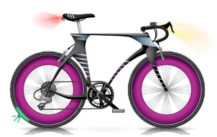
Product mix – O-8 Speed Bike
14 – Speed (Soon to be 11)
Puncture resistant, sleek, racing tires
Aerodynamic dropdown handlebars
Lights & Precision Braking
$1,400 with $100 rebate
Competitive with market rates

Slide 8
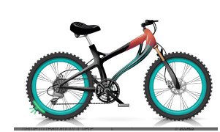
Product mix – n-7 mountain bike
24 – Speed
Puncture resistant & high grip tires
Elegant thin brushstrokes for style
Superior Standard Brakes
$1,350 with $100 rebate
Competitive with market rates

Slide 9
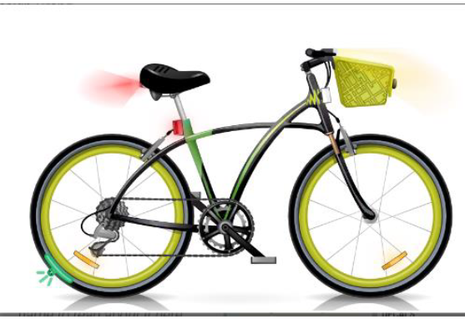
Product mix – he-2 recreational bike
14 - Speed
Puncture resistant tires
Colorful, thin brushstrokes for style
Reflectors for increased safety
$950 with $150 rebate
Competitive with market rates

Slide 10
Sales channels
Brick-and-Mortar:
New York City
Rio de Janeiro
Amsterdam
Online:
Bangalore

Slide 11
Marketing Plan
Ben Benyehuda – CMO & VP of Marketing
This department oversees ensuring our brand is being accurately represented in the market, along with the creation of advertisements and the design of our bikes, they work in tandem with sales to make sure consumers are responding well to our decisions.

Slide 12
Market research
The best bike in the market is the bike that fits the customers needs!
We focused our market research on what our customers want under each market segment

Slide 13
Market research findings
The Speed and Mountain include mostly professional riders.
The Recreation includes the average daily bike user.
All the components of our bikes are based of the findings of the market research.
The Speed Segment | The Mountain Segment | The Recreation Segment
Fast | Easy on Steep Climbs | Easy
Lightweight | Can handle rough terrain | Comfortable
Aerodynamic | Durable | Simple
Competitive advantage | Soft impact on rider | Safe

Slide 14
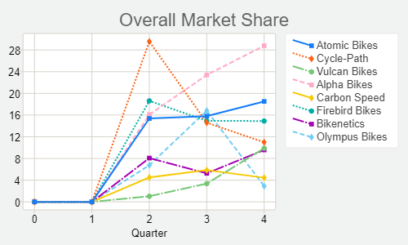
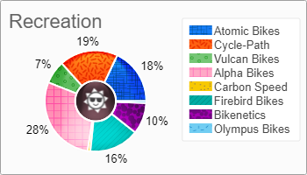
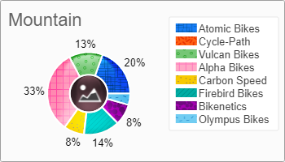
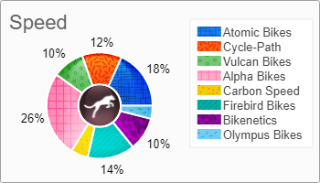
Market Share
2nd in overall market share
2nd in market share of speed and mountain segment
3rd for the recreation segment

Slide 15
How & Where we advertise
Major Media Platforms
Verity of Magazines, depending on the segments interest
Social Media
Social Networking
Blogs & Newsletters
Online
Search Engine Optimization
SEM Biding

Slide 16
Operating Plan
Gus Lipkin – CIO & VP of Manufacturing
Manufacturing: While overseeing the hiring of production workers, this department works in tandem with marketing to design and create the bikes we produce. They monitor and project demand quarterly, to ensure enough bikes are produced and orders fulfilled.

Slide 17


Slide 18
Bringing a personalized experience to the bicycle industry
Human Resources
Sales and Service Staff
Producing to Meet Demand
Notes:
HR solid foundation
Happy employees make happy customers
Produce to meet demand

Slide 19
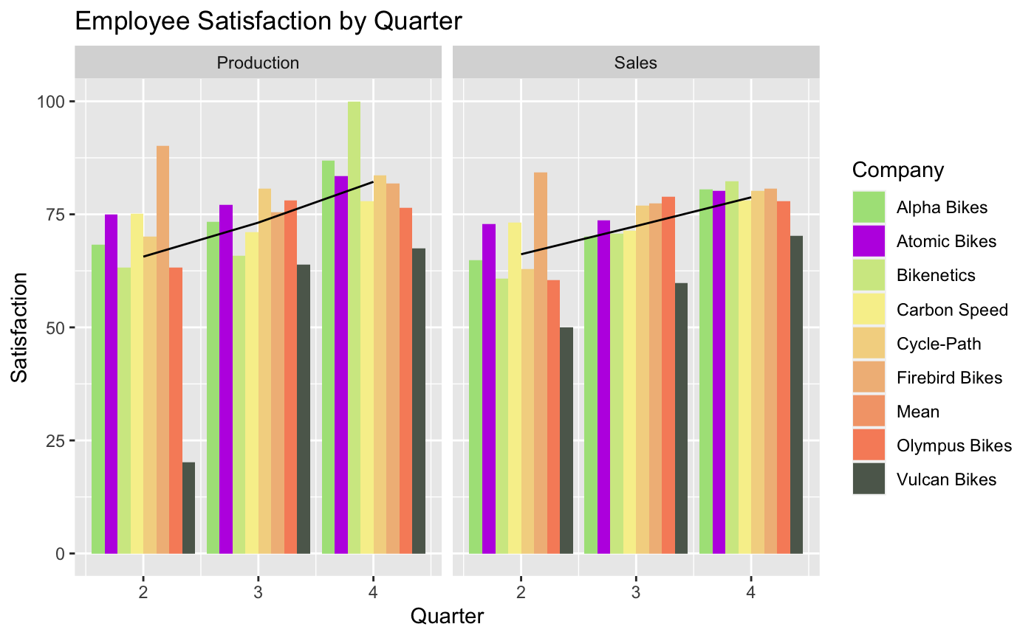
Human Resources
Employee Satisfaction
Notes:
Above average and climbing. Aiming for industry highs

Slide 20
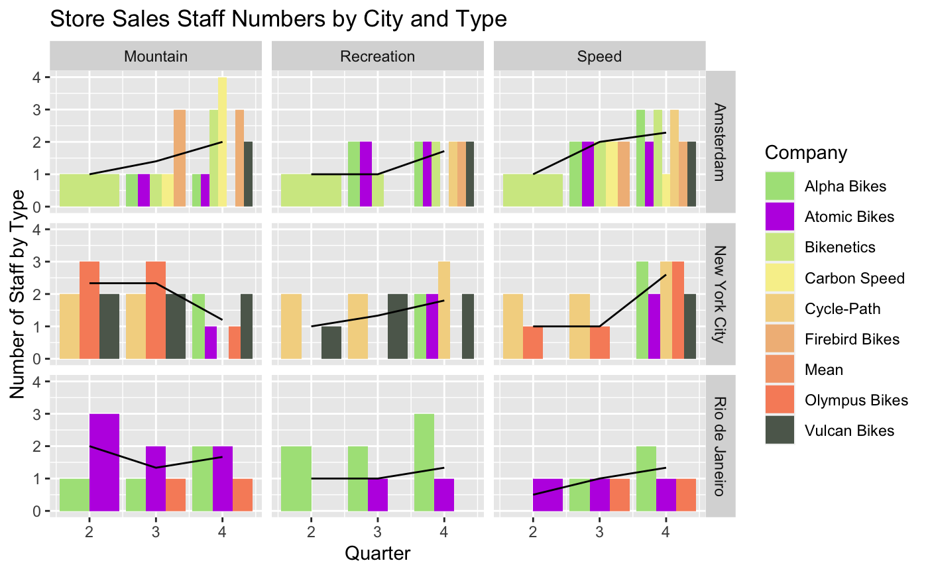
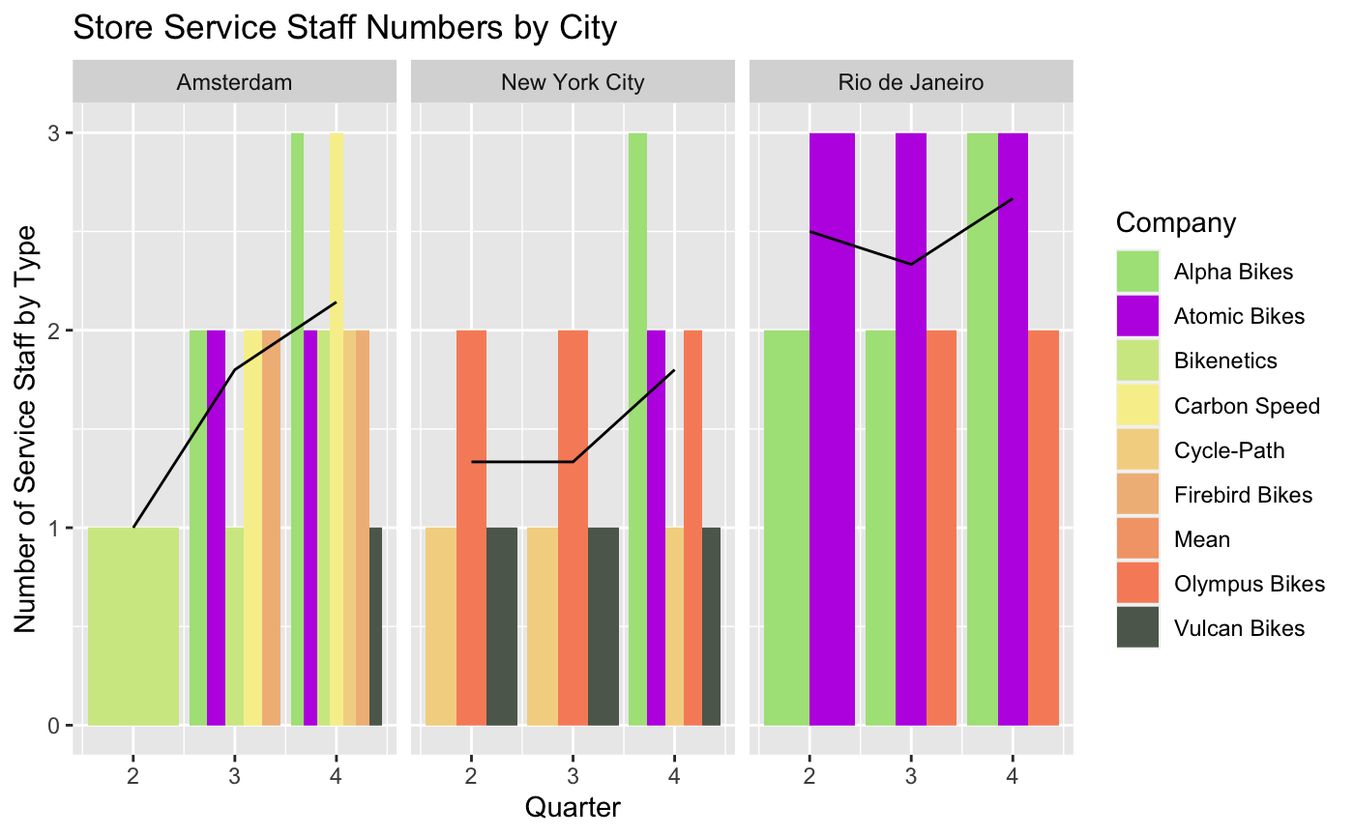
Sales and Service staff
Notes:
We meet or exceed market averages in every segment in every market we operate in

Slide 21
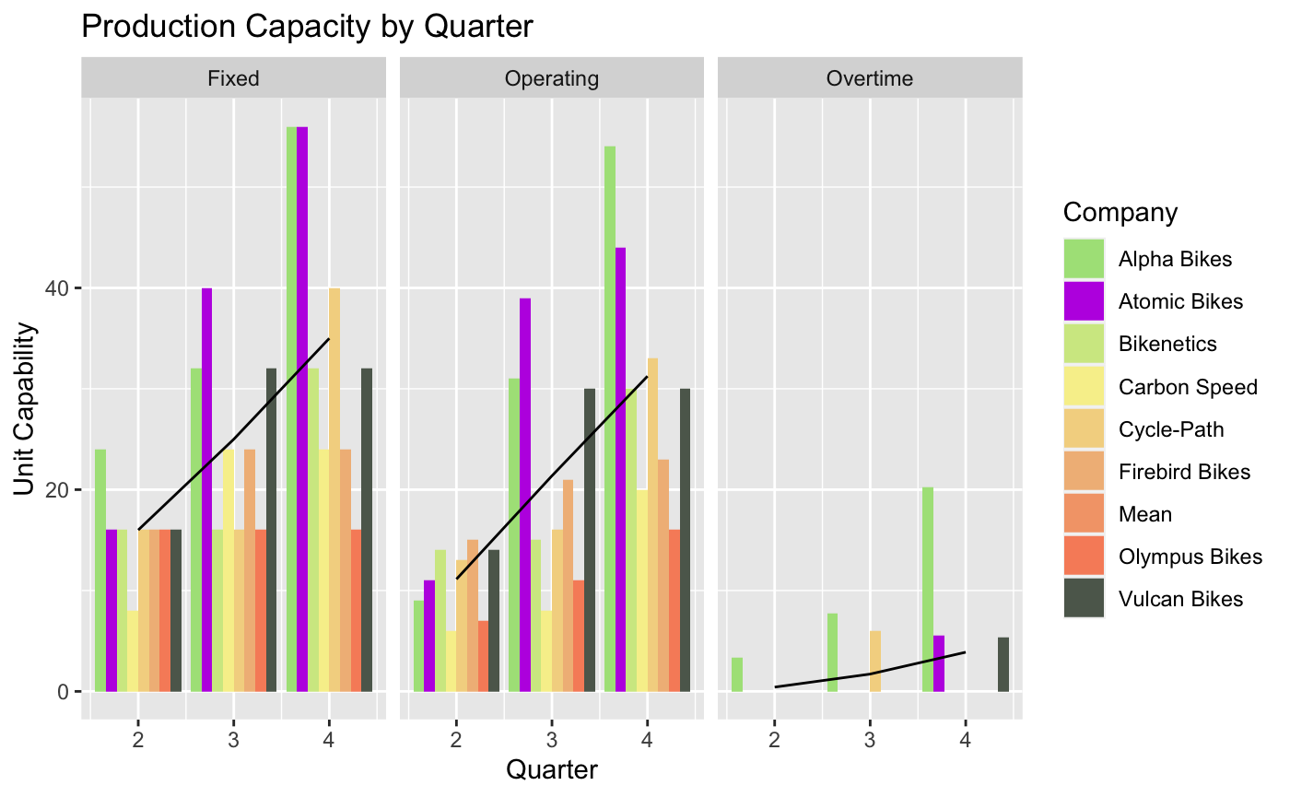
Production Capacity
Capacity by Quarter
Notes:
Capacity grows exponentially to meet soaring demand. Aiming to double for next quarter

Slide 22
Financial Statements
Richard Martin – CFO & VP of Finance & Accounting
This department works in tandem with all departments, to make sure all finances balance out, as we try to maximize profit while simultaneously achieving our company goal.

Slide 23

Atomic bikes is seeking an investment

Slide 24
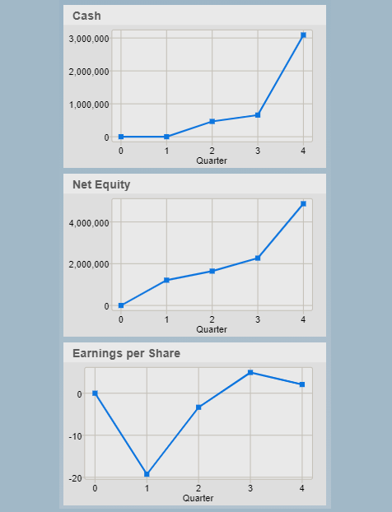
Financial Statements
High liquidity starting Quarter 5
Using cash for R&D, Marketing, and manufacturing
Ratios
Gross profit ratio of 56.29
Gross profit/revenue
Current assets ratio of 2.13
Net income/total assets
Debt Ratio of 0

Slide 25
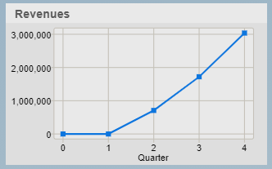
Financial Statements
Projections for Quarter 5 and Quarter 6
Current assets ratio expected to increase from 2.16 to 11.53 by Q6
13% projected increase in equity
From -$26 to $16 in earnings per share projected
Financial History
Average quarterly increase in revenue is 88%

Slide 26
Atomic Bikes Business Plan
Austin Adams – CEO
Ben Benyehuda – CMO
Arden Geffen – COO
Gus Lipkin – CIO
Richard Martin – CFO

